Slide 1

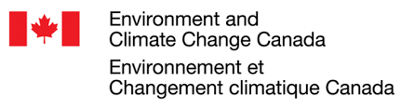










Multi-model Intercomparison Project on the Saskatchewan-Nelson-Churchill River Basin (Nelson-MiP project)
Monthly meeting - May 13th, 2020
Manitoba Infrastructure

Slide 2
Agenda
Presentation of results from a MiP project led by AEP (Khaled - AEP)
Presentation of VIC configuration and input (Raj - UNBC)
Presentation of SUMMA configuration and input (Wouter - USask)
OneDrive repository for data storage & retrieval
Deliverables for next meeting & follow-up

Slide 3
AEP-led MiP project
By:
Khaled Akhtar
(Alberta Environment & Parks)

Slide 4
The Variable Infiltration Capacity (VIC) Model
By:
Rajtantra Lilhare
(University of Northern British Columbia)

Slide 5
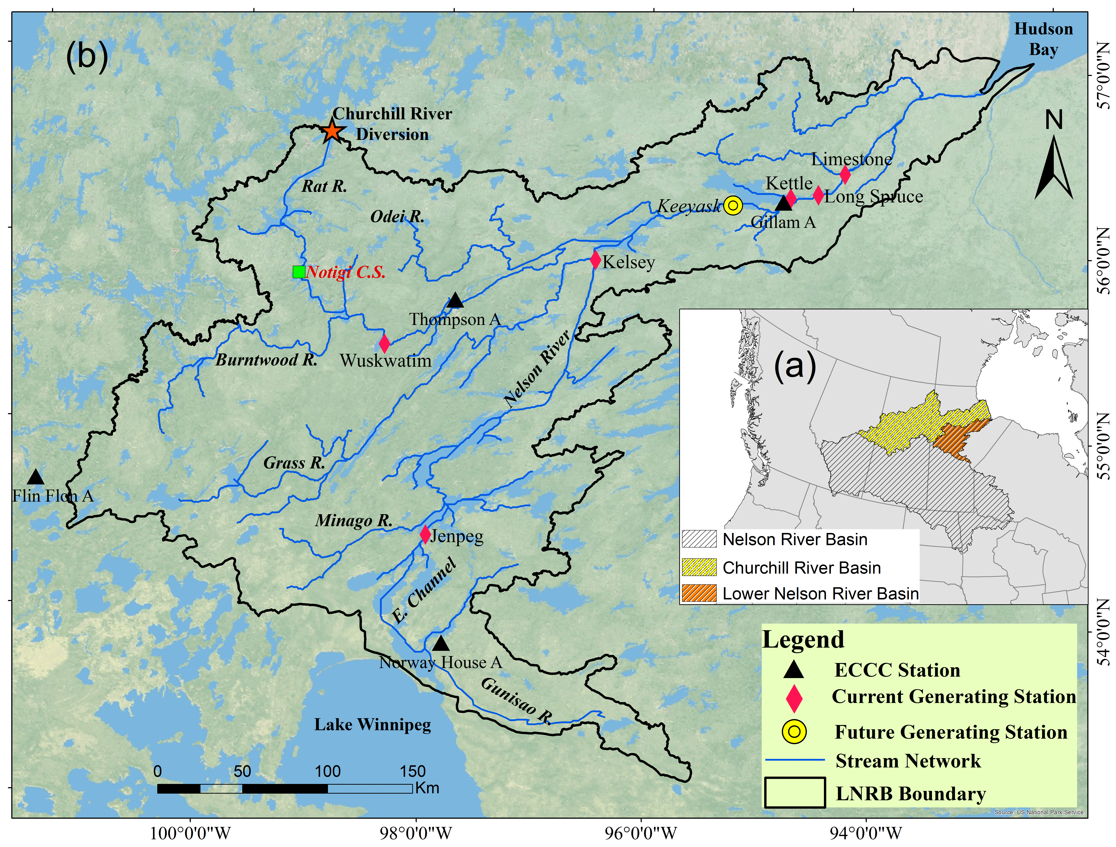
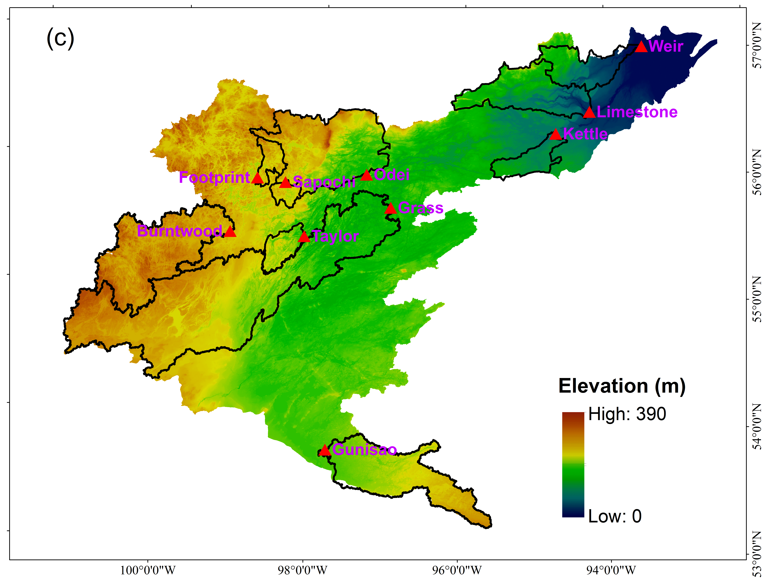
1. Study Area
The Lower Nelson River Basin (LNRB)
Receiving major outflow from the Nelson River Basin (~970,000 km²)
The LNRB area: ~90,580 km²
Churchill River Diversion started in 1977, operated by Manitoba Hydro
Managed at Notigi Control Structure on the Rat River
Characteristic/ Data type | Information/Product | Source
Topography | USGS: Hydro1K | https://lta.cr.usgs.gov/HYDRO1K
Soil characteristics | Harmonized World Soil Database V1.2 | Nachtergaele et al. (2010)
Land use | ESA CCI LC 2010 v1.4 | ESA Climate Change Initiative
Lake and wetland | Global Lake and Wetland Database (GLWD) | Lehner and Doll (2004)
Reservoirs | Global reservoir and Dam database (GRanD) v1.1 | Lehner et al. (2011)
Discharge | HYDAT, 2. USGS | Environment Canada waterdata.usgs.gov/nwis
Meteorological | Hydro-GFD | Berg et al. (2017)
Snow | GlobSnow | www.globsnow.info
Glacier fluctuations | World Glacier Monitoring Service (WGMS) | Zemp et al. (2009)
Evapotranspiration | FLUXNET | fluxnet.ornl.gov

Slide 6
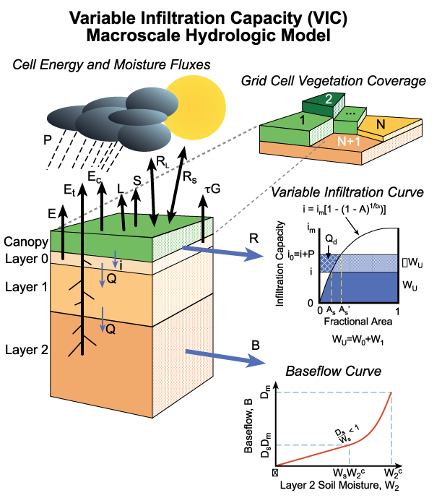
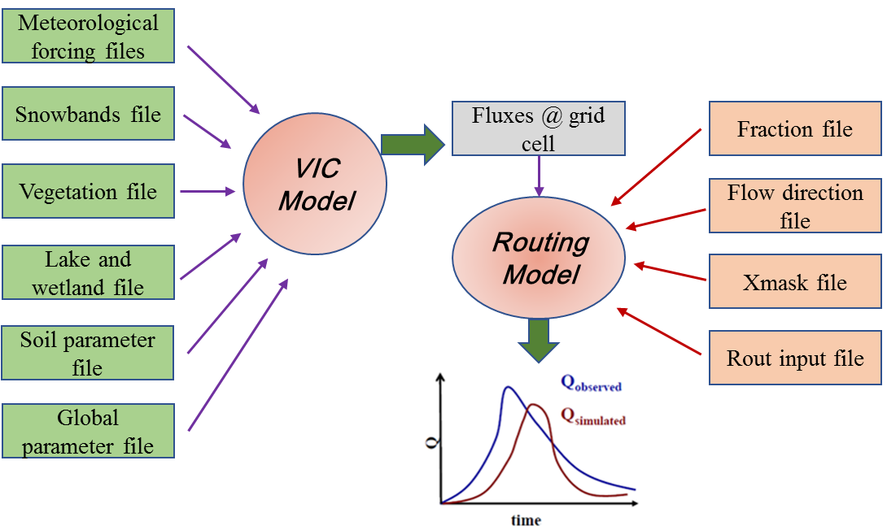
2. Model Description
The Variable Infiltration Capacity Model
Source: http://vic.readthedocs.io/en/master/Overview/ModelOverview/

Slide 7
3. Input Data Used
Table 1 Description of the input data used for the VIC model setup and their sources
Characteristic/Data type | Information/Product | Source
Topography | 90 m Shuttle Radar Topography Mission (SRTM) digital elevation model | United States Geological Survey (2013)
Soil characteristics | The multi-institution North American Land Data Assimilation System (NLDAS) project at 0.50° resolution | Cosby, Hornberger, Clapp, & Ginn (1984)
Land use | GeoGratis - Land Cover, circa 2000-Vector (LCC2000-V) product | Natural Resource Canada (2000)
Lake and wetland | Global Lake and Wetland Database (GLWD) | Lehner and Doll (2004)
Discharge | HYDAT, 2. Manitoba Hydro | Water Survey of Canada
Meteorological forcings | Hydrological Global Forcing Data (Hydro-GFD) | Berg et al. (2017)

Slide 8
3. VIC Calibration
VIC Calibration and Validation:
Parameter [units] | Definition | Range
b_{inf} [fraction] | Parameter used to describe the variable infiltration curve | > 0 to 0.40
Ds [fraction] | Fraction of the Ds_{max} parameter at which nonlinear base flow occurs | > 0 to 1
Ws [fraction] | Fraction of maximum soil moisture where nonlinear base flow occurs | > 0 to 1
D2 [m] | Depth of second soil layer | 0.3 to 1.5
D3 [m] | Depth of third soil layer | 0.3 to 1.5
Ds_{max} [mm day⁻¹] | Maximum velocity of base flow for each grid cell | > 0 to 30
Daily and monthly calibration using the University of Arizona multiobjective complex evolution (MOCOM-UA) optimizer.
Years 1981–1985 (dry/cool) and 1995–1999 (wet/warm) are used for calibration, and 1986–1994 (average) forms the validation period.

Slide 9
THANK YOU!
Questions?

Slide 10
Structure for Unifying Multiple Modeling Alternatives (SUMMA)
By:
Wouter Knoben
(University of Saskatchewan)

Slide 11
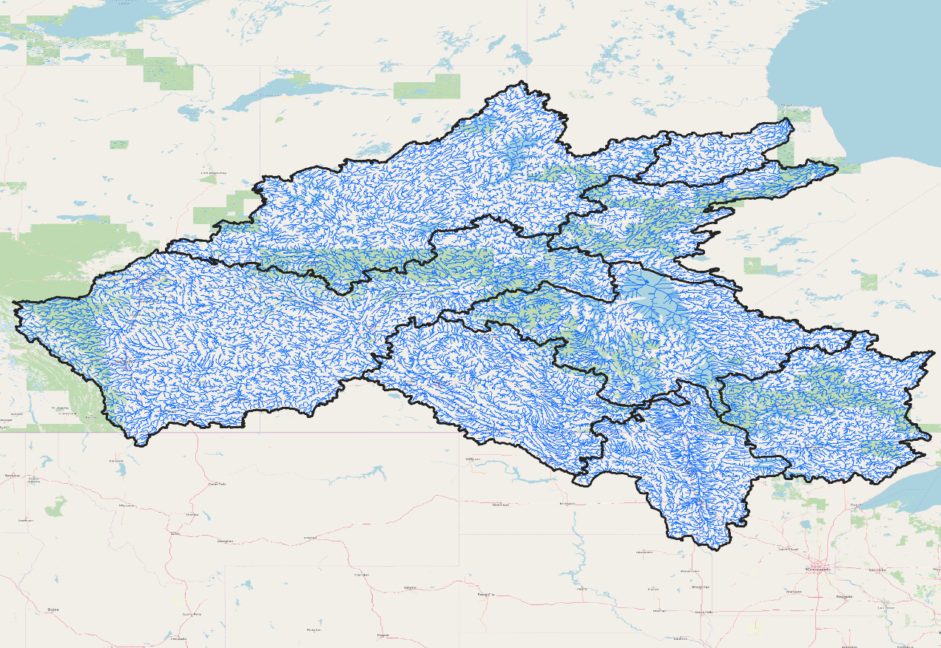
1. Study Area
Nelson Churchill River Basin
Gross Area
1.4 million square kilometers
Elevation Range
Sea level to 3548 M.S.L.
Exact configuration to be decided, but Pfaffstetter coding of river network allows flexible aggregating of catchments without need to reconfigure routing
Figure 1 Main Nelson sub-basins with MERIT stream network
Characteristic/ Data type | Information/Product | Source
Topography | USGS: Hydro1K | https://lta.cr.usgs.gov/HYDRO1K
Soil characteristics | Harmonized World Soil Database V1.2 | Nachtergaele et al. (2010)
Land use | ESA CCI LC 2010 v1.4 | ESA Climate Change Initiative
Lake and wetland | Global Lake and Wetland Database (GLWD) | Lehner and Doll (2004)
Reservoirs | Global reservoir and Dam database (GRanD) v1.1 | Lehner et al. (2011)
Discharge | HYDAT, 2. USGS | Environment Canada waterdata.usgs.gov/nwis
Meteorological | Hydro-GFD | Berg et al. (2017)
Snow | GlobSnow | www.globsnow.info
Glacier fluctuations | World Glacier Monitoring Service (WGMS) | Zemp et al. (2009)
Evapotranspiration | FLUXNET | fluxnet.ornl.gov

Slide 12
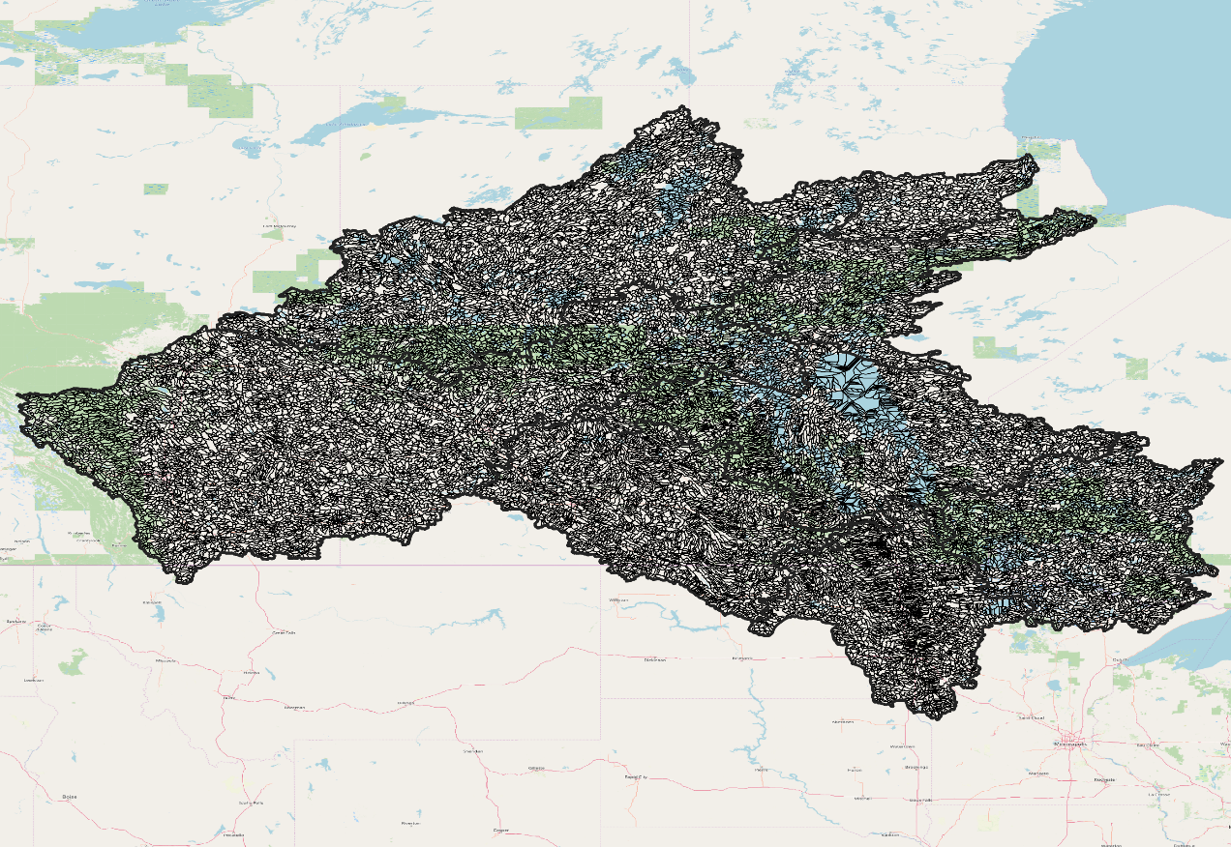
1. Study Area
Nelson Churchill River Basin
Gross Area
1.4 million square kilometers
Elevation Range
Sea level to 3548 M.S.L.
Exact configuration to be decided, but Pfaffstetter coding of river network allows flexible aggregating of catchments without need to reconfigure routing
Figure 1 Main Nelson sub-basins with MERIT Hydro catchment delineation
Characteristic/ Data type | Information/Product | Source
Topography | USGS: Hydro1K | https://lta.cr.usgs.gov/HYDRO1K
Soil characteristics | Harmonized World Soil Database V1.2 | Nachtergaele et al. (2010)
Land use | ESA CCI LC 2010 v1.4 | ESA Climate Change Initiative
Lake and wetland | Global Lake and Wetland Database (GLWD) | Lehner and Doll (2004)
Reservoirs | Global reservoir and Dam database (GRanD) v1.1 | Lehner et al. (2011)
Discharge | HYDAT, 2. USGS | Environment Canada waterdata.usgs.gov/nwis
Meteorological | Hydro-GFD | Berg et al. (2017)
Snow | GlobSnow | www.globsnow.info
Glacier fluctuations | World Glacier Monitoring Service (WGMS) | Zemp et al. (2009)
Evapotranspiration | FLUXNET | fluxnet.ornl.gov

Slide 13
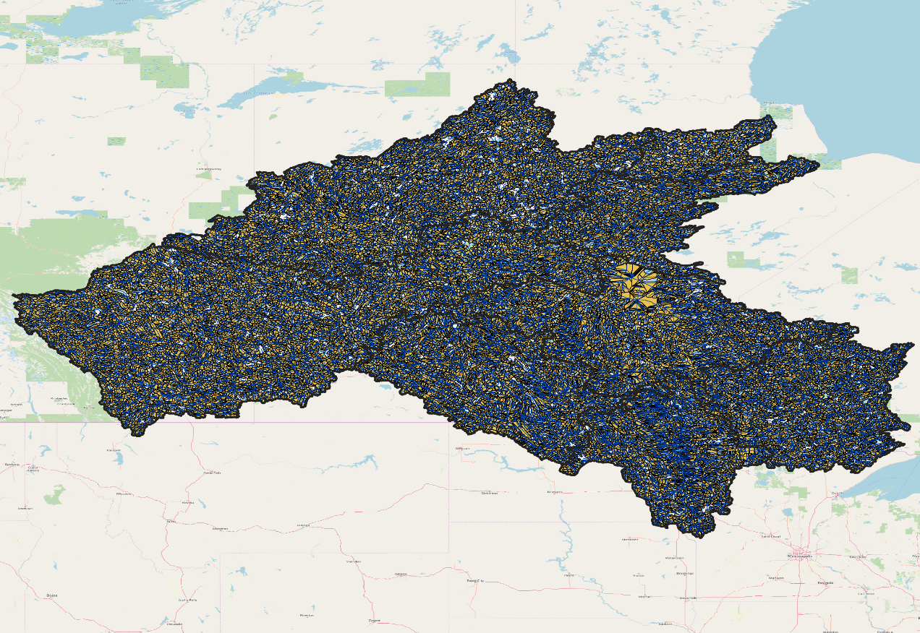
1. Study Area
Nelson Churchill River Basin
Gross Area
1.4 million square kilometers
Elevation Range
Sea level to 3548 M.S.L.
Exact configuration to be decided, but Pfaffstetter coding of river network allows flexible aggregating of catchments without need to reconfigure routing
Figure 1 Main Nelson sub-basins with MERIT Hydro catchment delineation and stream network
Characteristic/ Data type | Information/Product | Source
Topography | USGS: Hydro1K | https://lta.cr.usgs.gov/HYDRO1K
Soil characteristics | Harmonized World Soil Database V1.2 | Nachtergaele et al. (2010)
Land use | ESA CCI LC 2010 v1.4 | ESA Climate Change Initiative
Lake and wetland | Global Lake and Wetland Database (GLWD) | Lehner and Doll (2004)
Reservoirs | Global reservoir and Dam database (GRanD) v1.1 | Lehner et al. (2011)
Discharge | HYDAT, 2. USGS | Environment Canada waterdata.usgs.gov/nwis
Meteorological | Hydro-GFD | Berg et al. (2017)
Snow | GlobSnow | www.globsnow.info
Glacier fluctuations | World Glacier Monitoring Service (WGMS) | Zemp et al. (2009)
Evapotranspiration | FLUXNET | fluxnet.ornl.gov

Slide 14
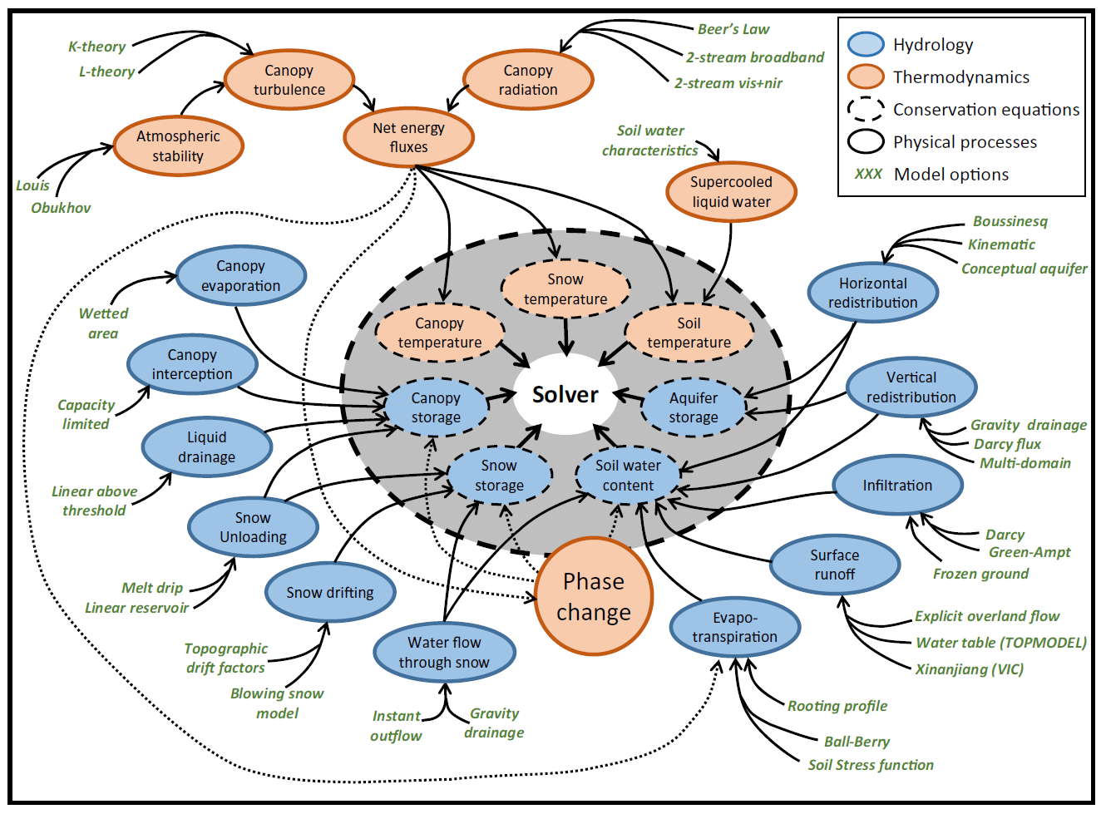
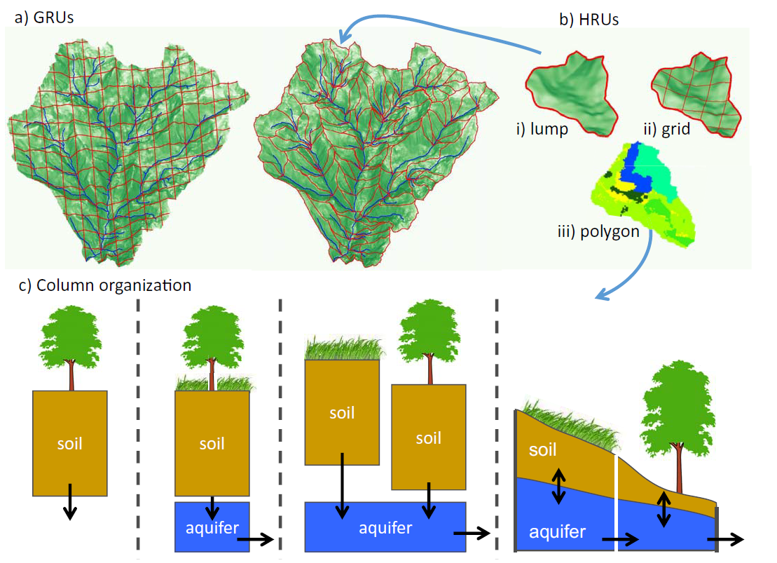
2. Model Description
Figure 2 SUMMA setup: multiple modeling options are part of a common numerical solver
Figure 3 Spatial organization is flexible
Figures from Clark et al. (WRR, 2015)
Notes:
SUMMA solves energy and water balance simultaneously
SUMMA provides different options for the main hydrologic processes
Numerical solving is cleanly separated from the model equations
Spatial organization is flexible
Temporal resolution is a user choice

Slide 15
3. Input Data Used
Table 1 Description of the input data used for the model setup and their sources
Characteristic/ Data type | Information/Product | Source
Topography | MERIT Hydro | Yamazaki et al. (2019)
Soil characteristics | SOILGRIDS | Hengl et al. (2017)
Land use | MODIS Vegetation | Didan et al. (2010)
Lake and wetland | MERIT Hydro (lakes) | Yamazaki et al. (2019)
Reservoirs | n/a | Planned as future development
Discharge | tbd
Meteorological | ERA5 | Copernicus Climate Change Service (2017)
Snow | n/a | Calculated internally
Glacier fluctuations | n/a | Planned as future development
Evapotranspiration | n/a | Calculated internally

Slide 16
Data exchange for Nelson-MiP
UC-HAL is providing a private OneDrive repository named Nelson MIP for data storage and retrieval for this project.
All project participants will have a read-only access to the repository and thus can access/download inputs and other modelers’ outputs.
For data upload (e.g. model outputs) you will have to send me or Trish and email with a link to the data to be uploaded.
If you are NOT willing to share your model outputs and model configuration open source with others? Please let us know before submitting any data. Accommodations can be made, but the preference is that all models and data are shared.
When using data from other modellers, we require you to get their written consent and inform the project coordination prior to any form of publication.

Slide 17
Data exchange for Nelson-MiP
3 folders in Nelson MIP: Model_results
Input_data_NCRB Reports_monthly_meetings
In the sub-folder Input_data_NCRB we have folders for:
- GSDE soil data for NCRB
- NALCMS land use data for NCRB
- natural gauge stations for calibration (i.e. list of stations in excel file and streamflow data in native formats)
- shapefiles of modelling domain and mask
- WFDEI data for NCRB
In each data folder a README_ME_FIRST.txt file explains the contain of the folder.

Slide 18
Deliverables & Follow-up
Model presentations on SWAT-GWF (Ualberta) and HEC-HMS (Strategic Consulting) are confirmed for next meeting.
Presentation of a new hydrologic routing during next meeting by Bryan Tolson (UWaterloo)
Comparison of ERA5 and WFDEI-GEM-CaPA by Scott Pokorny (Strategic Consulting) during next meeting
For MESH (USask), HBV-EC & WATFLOOD-MI (Manitoba Infrastructure), send your slides by June 3 if you are interested in presenting your model.
UC-HAL have granted read-only access to OneDrive project repository (Nelson-MIP) to all project participants. Reach out to Trish if you don’t have access yet and to me for data issue.
Start of model setup before next meeting, once access to data is granted. Discuss/report challenges using the SLACK channel
A SLACK channel is available to facilitate informal communication for Nelson-MiP
Channel link: https://uc-hal.slack.com/archives/C011BTG7GL8
Channel name: #ncrb_mip
Next meeting scheduled for Wednesday June 10 @ 10:00AM MDT

